Slide 1
Might consensus seekers produce polarized society? Yes, they can!
František Kalvas, University of West Bohemia (Czech Republic, kalvas@kss.zcu.cz);
Ashwin Ramaswamy, Independent Researcher (India, ashwin.ramaswamy.92@gmail.com);
Ashley Sanders-Jackson, Michigan State University (USA, a.sanders.jackson@gmail.com);
Michael Slater, The Ohio State University (USA, slater.59@osu.edu)
Computing the Past 2022, Pilsen, October 7th

Slide 2
Main achievements of the project so far:
Project goal: to model the process of opinion polarization
Relevance for modelers of religion: -- our identity groups behave as groups of different religions: agents only seek consensus, no repulsion, but mebers of a group listen only to members of their group, not the others , -- our opinion dimensions might represent different dimensions of believes
Main achievements:
1) Results – identity and uncertainty/openness to different opinions makes main difference in polarization: also dimensions of opinion space decrease polarization, but average probability of speaking, conformity and structure of small-world network make no significant difference
2) Nonlinearity – identity and uncertainty/openness to different opinions nonlinearly change polarization: average polarization for certain sets of parameters is not representative, since these sets cause bifurcations – polarization is either high in some simulations or low but not average

Slide 3
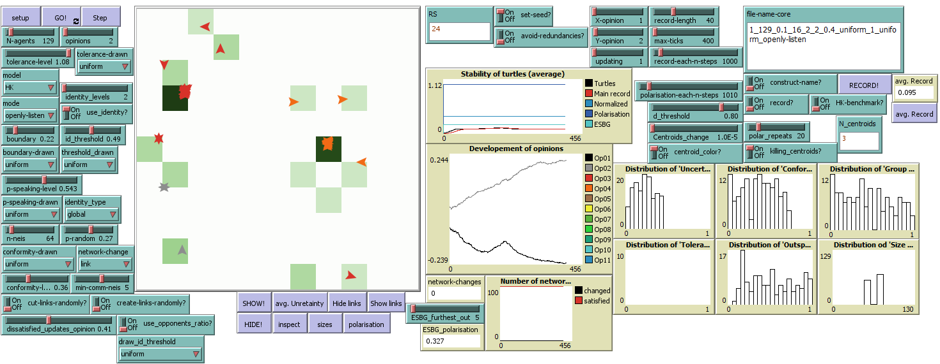
Basic model

Slide 4
Basic model
Classical Hegselmann-Krause
Every agent speaks out its opinion.
Agents take into account only opinions inside BOUNDARY given by their opinion and uncertainty/openness to different opinions – step function is used.
Agents estimate concensus as average of listened opinions.
Agents update opinion – they ‚move‘ toward estimated consensus with speed given by their beta/CONFORMITY (the higher conformity the faster and closer to consensus).
Both main parameters – margin of BOUNDARY and CONFORMITY – are constant across all agents
Everything happens in 1D opinion space – agents discuss just one issue.

Slide 5
Basic model
Advancements of Hegselmann-Krause in present model
We use more dimensions of opinion space than just 1D.
Agents speak out their opinion with a probability – not everyone speaks always.
Agents are connected with communication network (small-world) – they listen only to network neighbors.
Agents recognize identity groups according ‚Salience of Proximity in Identity Relevant Opinions‘ (SPIRO) – they listen only to their group members.
Margin of boundary, conformity, and speaking probability are random-unifomly distributed – parameters control population average of these variables.

Slide 6
Comparison of classical and advanced versions
Classical Hegselmann-Krause | Our model
Constant boundary | Random uniformly distributed boundary
Constant conformity (beta) | Random uniformly distributed conformity (beta)
One dimensional opinion space | Possibility of multiple dimensions
Difference in opinions as the only constraint | Euclidean distance in opinion space as one of constraints
No other constraints | Identity, communication network and speaking out as other constraints – agents consider only opinions from: (a) members of the same identity group, (b) who are also directly connected by edges of small-world communication network (i.e. they are neighbors), and (c) who speak their opinion out in present round of model run.

Slide 7
Basic model: Course of actions
Setup:
Position in opinion space, values of uncertainty/openness to different opinions, probability of speaking and conformity are randomly assigned to agents.
A round of model run:
Agents check constraints ( identity group ~ same or different group, openness to different opinions ~ distance in opinion space inside boundary, speaking ~ the other speaks, communication network ~ neighbor or not) and determine whom they listen to in the present round.
Agents find consesus of listened agents (average opinion) and moved towards it with speed given by the conformity.
Agents update communication network (rewiring link/neighborhood, non/randomly).

Slide 8
Identity recognition

Slide 9
Identity recognition
‚Global‘ identity recognition
1. Proximity of agents in opinion space are turned into weighted full network: p=1 ~ w=1; p=0 ~ w=0; p(1, 0) ~ w=p.
2. Then we reduce network followingly:
a. Edges with weight less than SPIRO are filtered out.
b. Nodes with one or zero edges are filtered out.
3. Then we perform Louvain on reduced network for community detection (maximization of edges within clusters, minimization of edges between clusters) – note: NetLogo uses Louvain that neglects weights.

Slide 10
Identity recognition
‚Global‘ identity recognition (continue)
4. Then we perform K-means clusters:
a. We use Louvain communities for definition of initial groups‘ centroids,
b. then we assign nodes/agents filtered in STEP 3 to nearest centroid,
c. we recompute centroids positions and check whether all agents are assigned to nearest centroid,
d. then we reassign agents wrongly associated and recompute centroids position until associations stabilize.
5. Identity group is then set of agents associated with same centroid.

Slide 11
Identity recognition
‚Individual‘ identity recognition
Each agent has its own randomly assigned value of SPIRO. The ideal then would be to run `Global identity recognition` for each agent, but it is computationally very demanding – Louvain is the most demanding part, speed of simulation slows down linearly with number of agents. So we:
Categorize individual SPIRO into few levels (2—10).
Then we perform `Global identity recognition` in each level of SPIRO. Speed of simulation slows down linearly only with number of levels.
It‘s not exact implementation of individual recognition of identity groups, but it is very good proxy.

Slide 12
Identity recognition

Slide 13
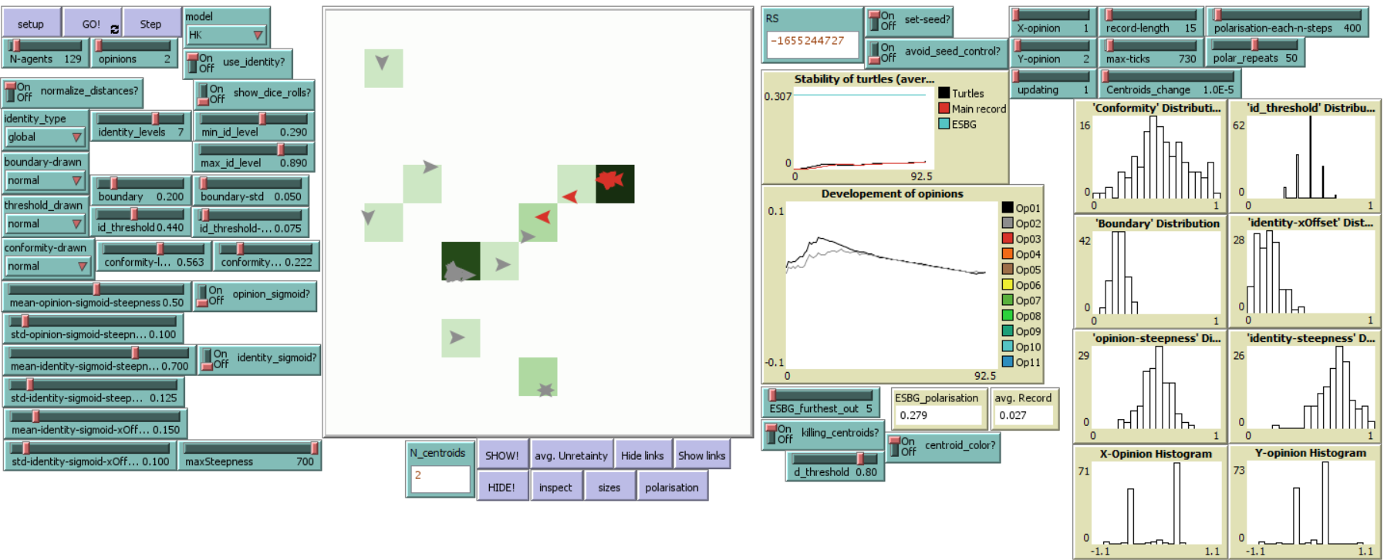
Identity recognition

Slide 14
Results

Slide 15
Results
METHODS
Netlogo¹. We utilize Netlogo, an agent-based modeling piece of software, to develop emergent systems to study the process of polarization
Hegselmann-Krause model (HK) ².
ESBG ³ measure of polarization (0-1 scale).
Stepwise regression. We completed a series of stepwise regression models to determine the impact of variables of interest on our ABM. We only display the final model on this handout.
REFERENCES:
Tisue, S., & Wilensky, U. (2004). NetLogo: Design and implementation of a multi-agent modeling environment. Proceedings of the Agent 2004 Conference on Social Dynamics: Interaction, Reflexivity and Emergence, Chicago, IL.
Hegselmann, R., & Krause, U. (2002). Opinion dynamics and bounded confidence models, analysis, and simulation. Journal of artificial societies and social simulation, 5(3).
Tang, T., Ghorbani, A., Squazzoni, F. et al. Together alone: a group-based polarization measurement. Qual Quant (2021). https://doi.org/10.1007/s11135-021-01271-y

Slide 16
Results
VARIABLES OF INTEREST
Opinions (1, 2, 4) indicating how many dimensions does the opinion space have.
Salience of proximity in identity relevant opinions (SPIRO) is measured using identity threshold (0-1 scale) which determines minimum similarity between two agents for them to be included in part of a community.
Openness to different opinions is measured using boundary (0-1 scale) with a boundary closer to 1 indicating a willingness to accept very different opinions and use them for updating own opinion.
Probability of speaking (0-1) with 1 indicating a greater probability of speaking.
Conformity level (0-1) with 1 indicating a greater conformity and a faster movement to seen concensus.
Rewiring (0-1) probability of rewiring edge of small-world network, with 1 indicating the network of interpersonal communication is close to random network, 0 indicating the clear small-world network.
Neighbors (1-128) number of neighbors in communication neighborhood.

Slide 17
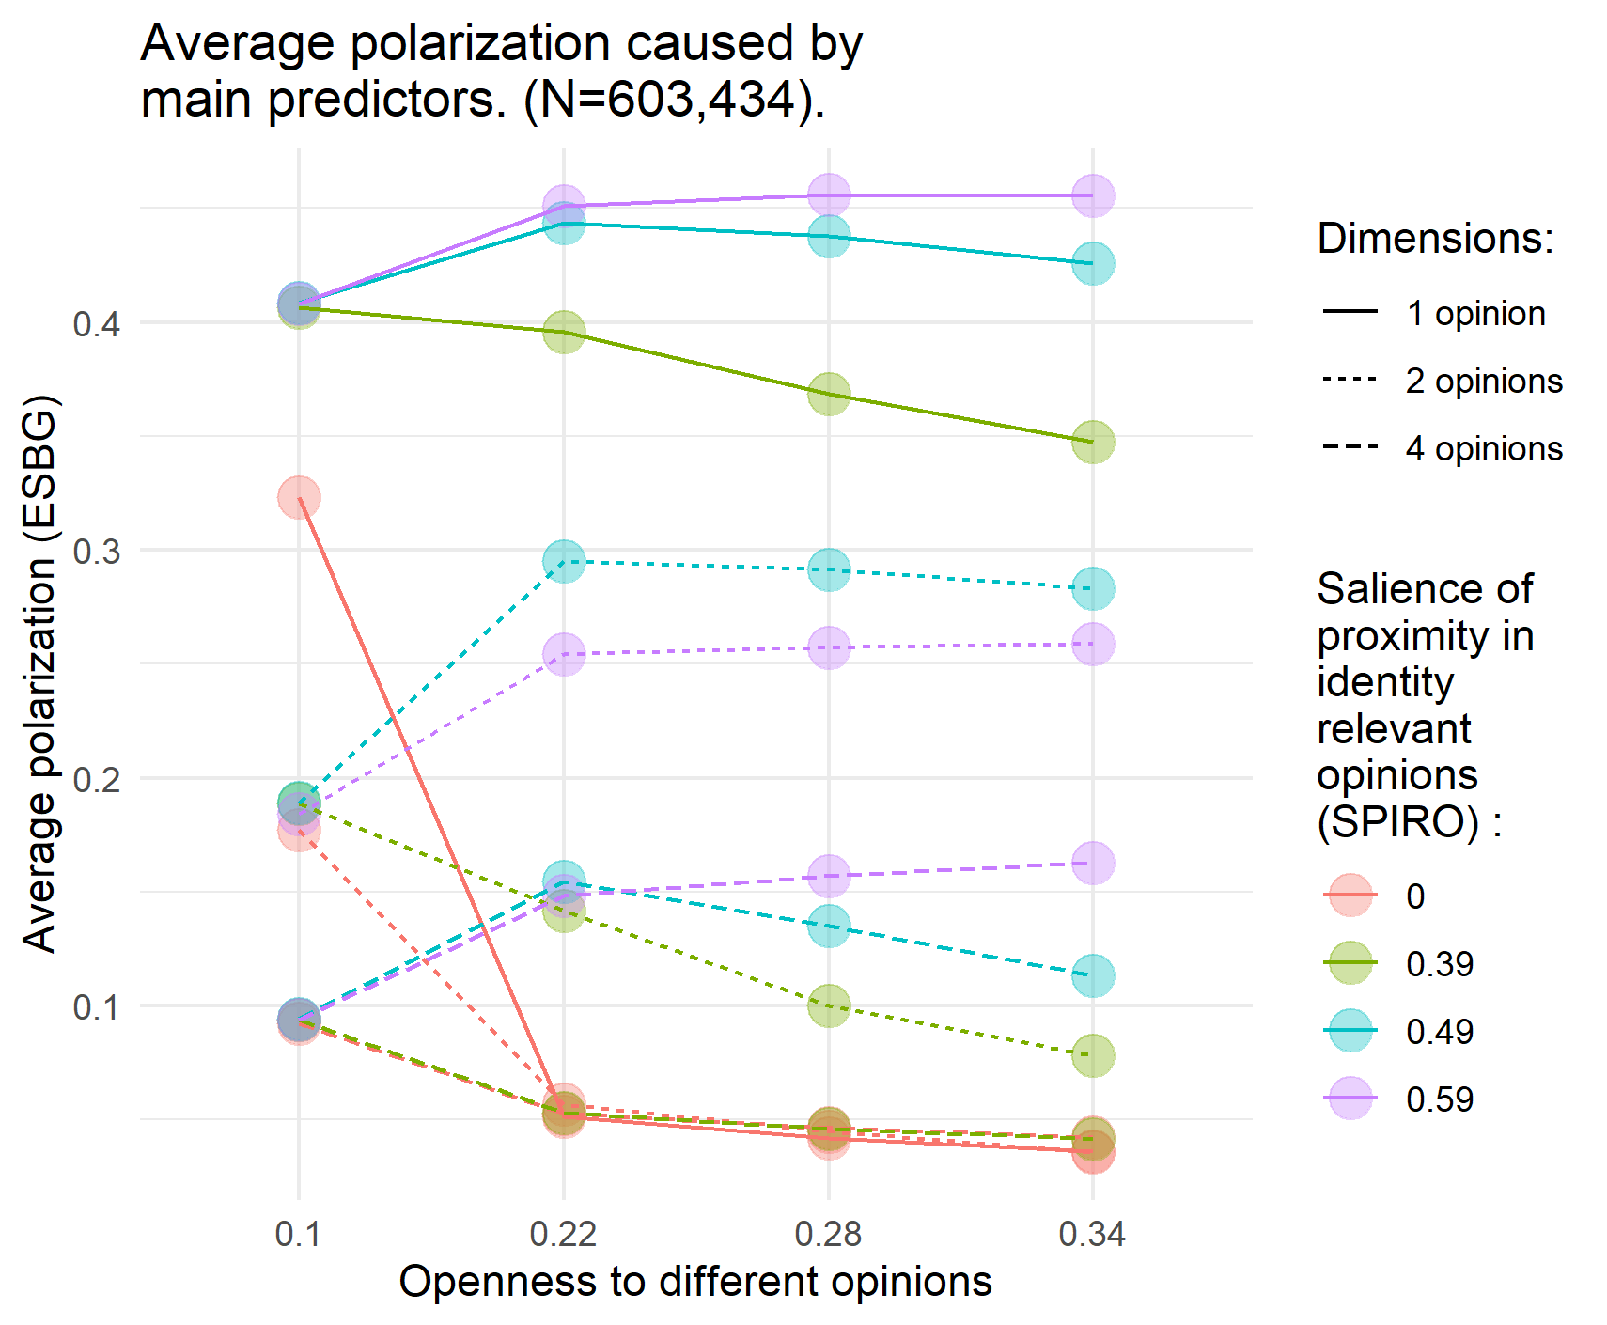
Results
Regression predicting contributors to polarization. (N=603,434; R²=51.6% ).
Variable | Coefficient
Opinions (2) | -0.159***
Opinions (4) | -0.244***
SPIRO (0.39) | 0.167***
SPIRO (0.49) | 0.263***
SPIRO (0.59) | 0.259***
Openness to diff. opinions | -0.194***
Probability of speaking | -0.012***
Conformity level | -0.003
Small-world: Rewiring | -0.003
Small-world: Neighbors | -0.0001***
Constant | 0.227***
*** significant at the .001 level

Slide 18
Nonlinearity

Slide 19
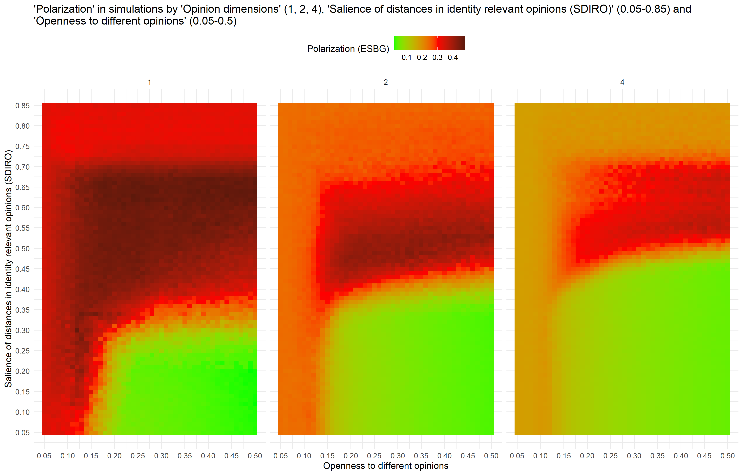

Slide 20
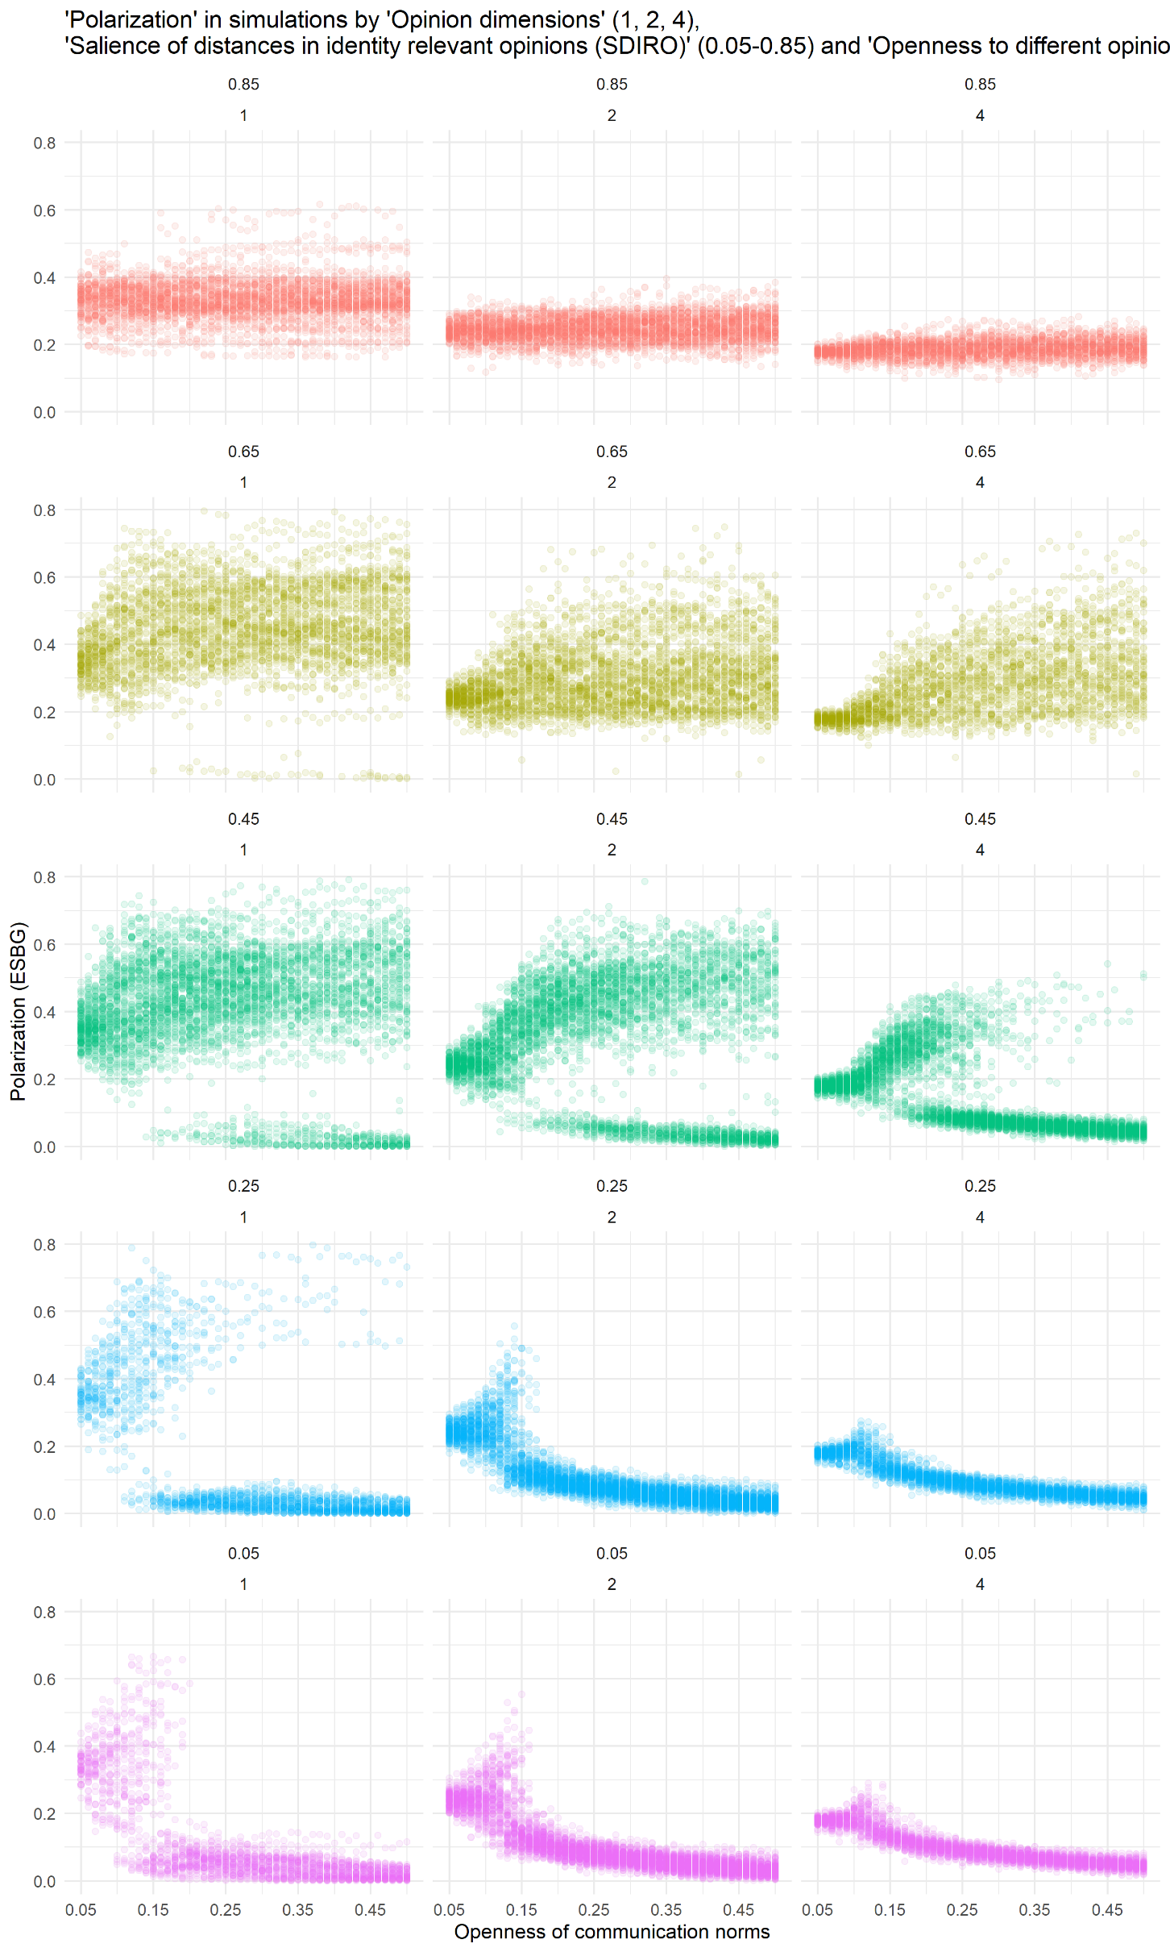
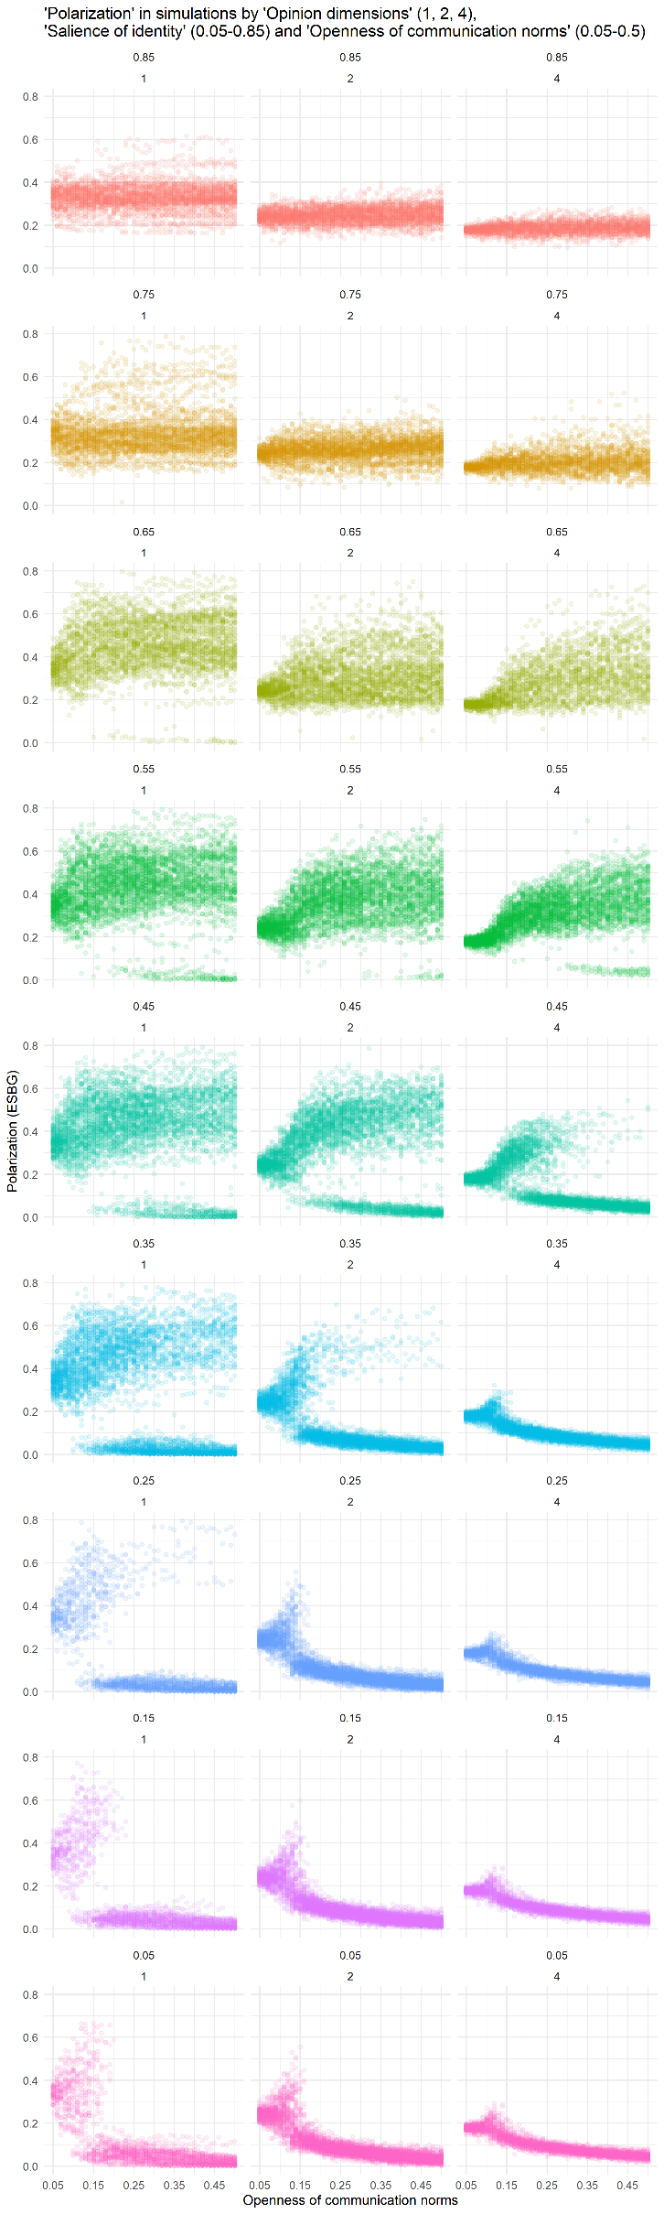

Slide 21
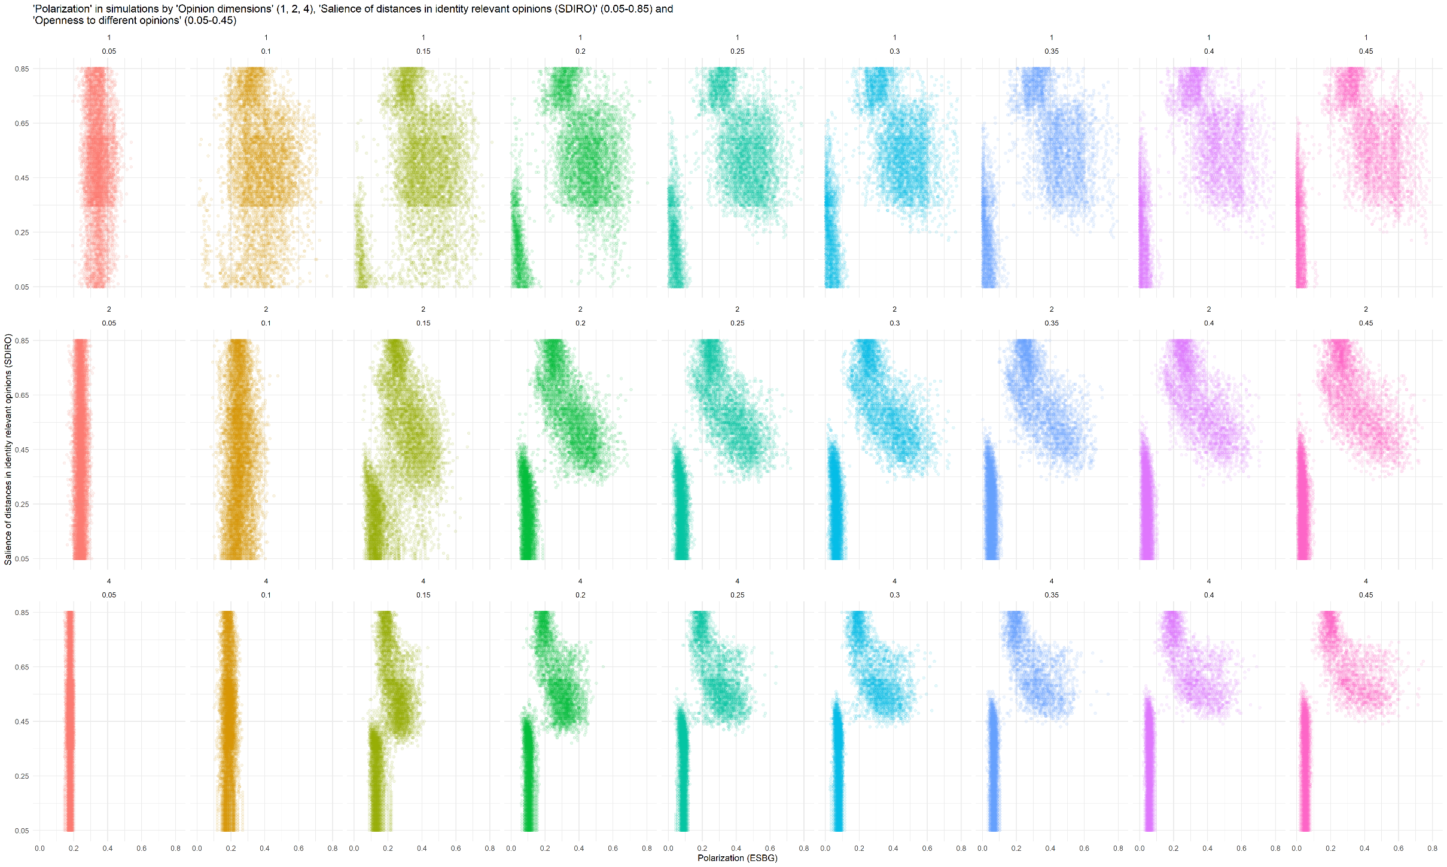

Slide 22
Further advancements

Slide 23
Further advancements

Slide 24
Further advancements
We apply sigmoids to differences in opinion position and identity group membership.
Normal distribution of randomly assigned parameters ( SPIRO [how agent recognizes identity groups], openness to other identity groups [how agent interacts with members of different groups], steepness of identity sigmoid [how agent interacts with members of different groups], uncertainity/openness to different opinion, steepness of opinion sigmoid, conformity)
We use for communication only full network and agents always speak their opinion out.

Slide 25
More on sigmoids
In later version we used step function: If the position in opinion space of other agent was in distance which was equal or less than value given by uncertainty/openness to different opinions, then opinions of the other agent were accepted and used for updating own opinion.
Same held true for identity groups – opinions of agents from same group were always accepted, but opinions of agents from different groups were always rejected.
Sigmoids work differently: Sigmoid nonlinearily models probability of acceptance of other agent.
In case of different positions in opinion space:
it gives probability 1 for distances in opinion space close to 0, it gives probability the closer to 0.5 the closer distance to the openness to different opinions,
it gives probability the closer to 0 the further distance from the openness to different opinions.
In case of identity groups:
probability is driven by distance of group centroids and the 0.5 value is given by openness to other identity groups.
Agents have different parameters (openness, steepness) for opinion and identity sigmoids.

Slide 26
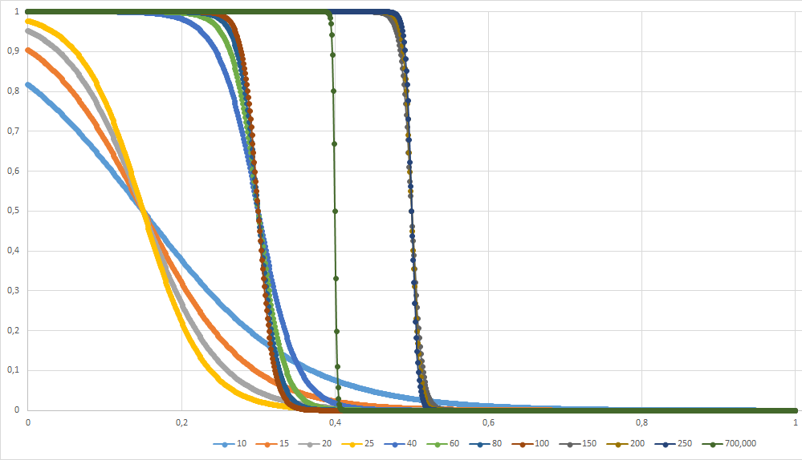
More on sigmoids
Equation:
p = 1 / (1 + exp (steepness * (distance – openness)))
steepness = {10, 15, 20, 25, 40, 60, 80, 100, … , 700}
openness = {0.15, 0.3, 0.4, 0.5}
Distance is Euclidean distance in opinion space: of two agents (opinion sigmoid) or of two groups` centroids (identity sigmoid).

